Slide 1
Global CO₂ Flux Inversions: Where do We Stand?
Sourish Basu, Kenneth Schuldt,
many generations of OCO MIP modelers, CO₂ data providers

Slide 2
Current status and lessons learned
Global CO₂ inversions with satellite data are routine. Satellite data have skill. The Global Carbon Budget includes satellite-based inversions.
Satellite records are now long enough to study response to climate anomalies (e.g., Metz et al, 2023, 2025; Liu et al, 2017; many others)
Having a controlled protocol for the OCO MIP has improved all models, and resulted in common good for all modelers
  How to bin/average satellite data
  How to validate inverse models
  Whole series of valuable side studies such as transport differences, SF₆, etc.
Inclusion of auxiliary data (SIF, OCS, ¹⁴C) also starting to become standard
Notes:
Metz et al (2023) : https://www.science.org/doi/abs/10.1126/science.add7833
Metz et al (2025) : https://bg.copernicus.org/articles/22/555/2025/
Liu et al (2017) : https://www.science.org/doi/10.1126/science.aam5690

Slide 3
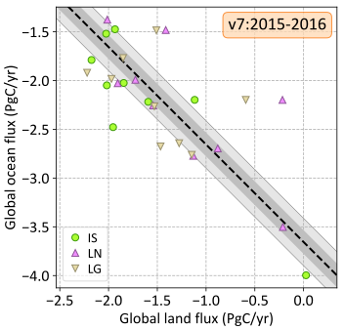
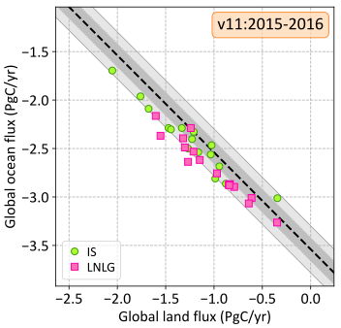
Progress over the last decade
Narrower land/ocean partitioning, better mass balance, even for the in situ inversions
Notes:
output_dir = os.path.join(os.environ['HOME'], 'Documents/Talks/OCO2/SAC Workshop')
fbp1.diver_down(['IS','LN','LG'], ('globe','globe'), ('land','ocean'), gr_cons=True, small_ticks=True, verbose=False, gr_tol=True, tol_method='diff', years=[2015,2016], range=2.88, annot_text='v7:2015-2016’)
savefig(os.path.join(output_dir, 'diver_down_land_ocean_v7.pdf')) ; close()
fbp4.diver_down(['IS', 'LNLG'], ('globe', 'globe'), ('land', 'ocean'), gr_cons=True, small_ticks=True, verbose=False, gr_tol=True, tol_method='diff', years=[2015,2016], range=2.88, annot_text='v11:2015-2016’)
savefig(os.path.join(output_dir, 'diver_down_land_ocean_v11.pdf')) ; close()

Slide 4
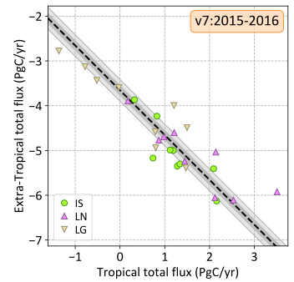
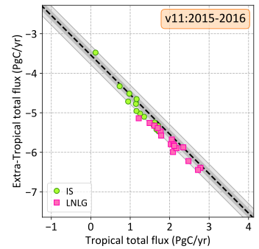
Progress over the last decade
The Tropical flux constraint from OCO2 is now far tighter
Notes:
output_dir = os.path.join(os.environ['HOME'], 'Documents/Talks/OCO2/SAC Workshop’)
fbp1.diver_down(['IS','LN','LG'], ('tropics', 'extra-tropics'), ('total','total'), gr_cons=True, small_ticks=True, verbose=False, gr_tol=True, tol_method='diff', years=[2015,2016], annot_text='v7:2015-2016', range=5.36)
savefig(os.path.join(output_dir, 'diver_down_tropics_v7.pdf')) ; close()
fbp4.diver_down(['IS','LNLG'], ('tropics', 'extra-tropics'), ('total','total'), gr_cons=True, small_ticks=True, verbose=False, gr_tol=True, tol_method='diff', years=[2015, 2016], annot_text='v11:2015-2016', range=5.36)
savefig(os.path.join(output_dir, 'diver_down_tropics_v11.pdf')) ; close()

Slide 5
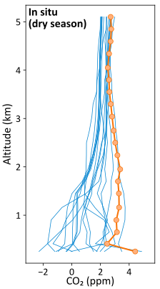
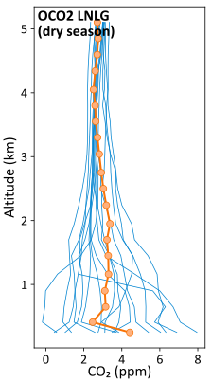
OCO2 data have new information
Tropical fluxes are better constrained with OCO2 data when they exist.
Comparison to aircraft profiles at Manaus (Brazil) shows that OCO2 inversions have more accurate fluxes, but only in the dry season. In the wet season, they’re the same or worse.
Notes:
Manaus_Profiles('LNLG', months=[6,7,8], xrange=9.3, annot_text=‘OCO2 LNLG\n(dry season)’)
savefig('manaus_dry_season_LNLG.pdf'); close()
Manaus_Profiles('IS', months=[6,7,8], xrange=9.3, annot_text=‘In situ\n(dry season)’)
savefig('manaus_dry_season_IS.pdf'); close()

Slide 6
Combination with auxiliary satellite data
Combination of satellite XCO₂ with satellite SIF to study the impact of anomalies on GPP and respiration (Parazoo et al, 2013; Sun et al, 2017; Byrne et al, 2018; Zhang et al, 2023; Jacobson et al, 2025; etc.)
Jacobson et al (2025) assimilates SIF and XCO₂ together instead of in steps, but for this approach to develop, we need a good mechanistic understanding of the SIF-GPP relationship (including structural errors)
NO₂ as a proxy for fossil CO₂ has also gained traction, but does not scale to global methods, mostly limited to urban/point sources
Notes:
Jacobson et al (2025) : 10.48550/arXiv.2503.09065

Slide 7
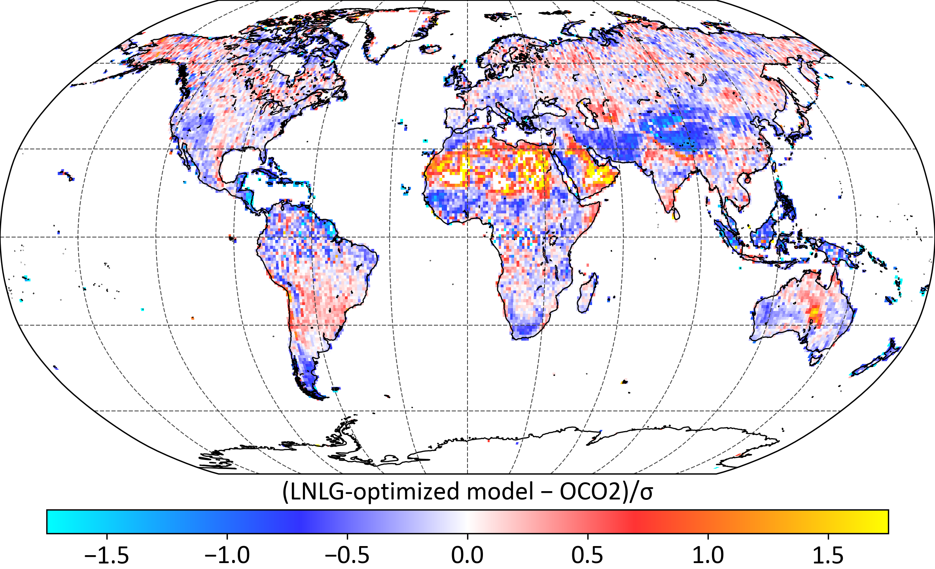
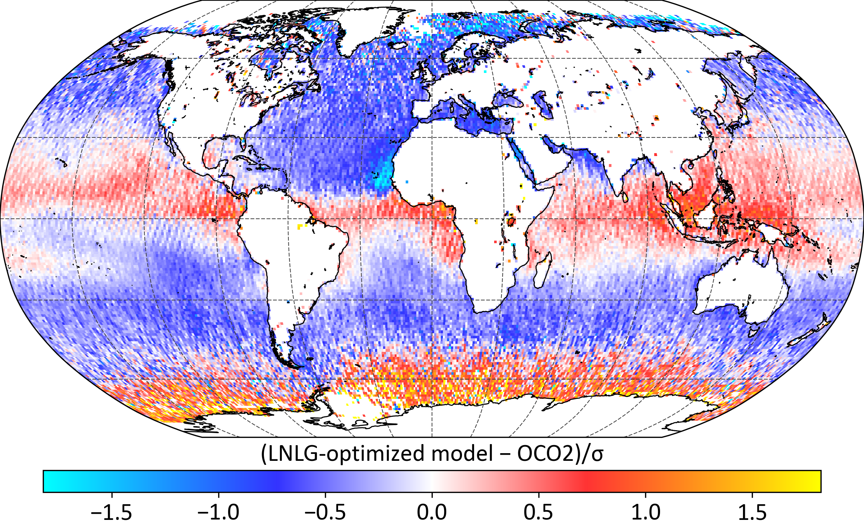
Current challenges
Global inversions are still very sensitive to coherent small biases in XCO₂ data, which is why the OCO ocean glint data are still not (widely) used. This will also be crucial to factor in when assimilating multiple satellite XCO₂
The size of the OG vs LNLG difference, relative to data uncertainty, is not especially large, but it is coherent over an area with naturally small variations in column CO₂
Notes:
Feng et al (2019) : https://agupubs.onlinelibrary.wiley.com/doi/10.1029/2019JD031165

Slide 8
Current challenges
Current inverse models are too slow; most struggle to deliver even 1°×1° fluxes, will likely struggle to assimilate the multi-satellite data deluge
Formal error estimation in iterative techniques ~100× expensive, and even then doesn’t factor in transport errors and assumptions in prior specification
We need gross fluxes to improve process models
Validating fluxes remains difficult (we have some methods, but they still rely on atmospheric samples, and they don’t work in under-sampled areas)
Inversions still struggle with non-uniform temporal coverage
Notes:
Feng et al (2019) : https://agupubs.onlinelibrary.wiley.com/doi/10.1029/2019JD031165

Slide 9
Dealing with instrument and inter-sensor bias
Current approach is to manually choose covariates against some truth metric(s), such as TCCON, models, or an assertion like “XCO₂ should not vary by more than X ppm over this area”
Some of this may be sped up by a machine learning model trained on the truth metrics, which may provide a more accurate error estimate on the bias correction
It is also possible to estimate this bias correction – per sensor, if needed – directly in any flux inversion that has a long enough window (1+ year)
Does not provide a “better” result than the standard approach, but may be more convenient/faster with multiple instruments?

Slide 10
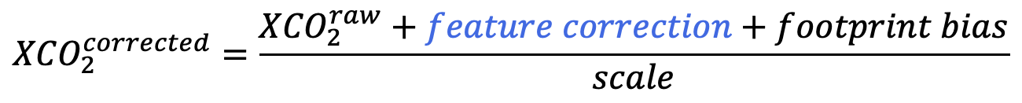
Online bias correction of OCO2 data circa 2017
$${XCO}_{2}^{corrected}=\frac{{XCO}_{2}^{raw}+feature correction+footprint bias}{scale}$$
Coefficients of the covariates estimated during a flux inversion
Correction | dp | logDWS | co2_grad_del | s31
ACOS official | 0.300 | 0.60 | 0.0280 | 7.0
LN | 0.296 | 0.68 | 0.0288 | 6.2
LN+LG+OG | 0.302 | 0.64 | 0.0282 | 6.6
LN + insitu | 0.295 | 0.68 | 0.0272 | 6.4
LN+TCCON | 0.297 | 0.67 | 0.0282 | 6.2
LN+TCCON+insitu | 0.294 | 0.68 | 0.0273 | 6.6
All+TCCON+insitu | 0.299 | 0.65 | 0.0273 | 6.7
Uncertainty (%) | 1 | 6 | 1.5 | 9

Slide 11
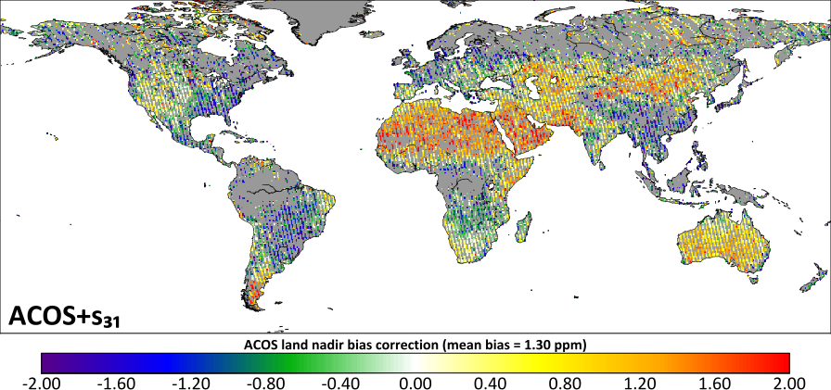
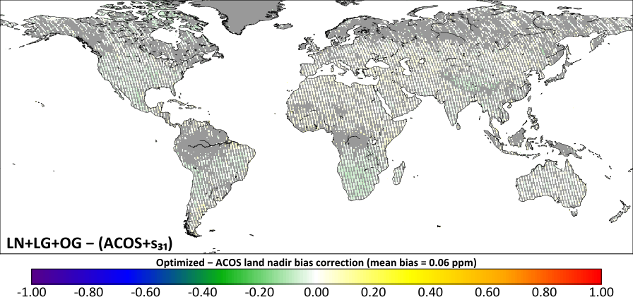
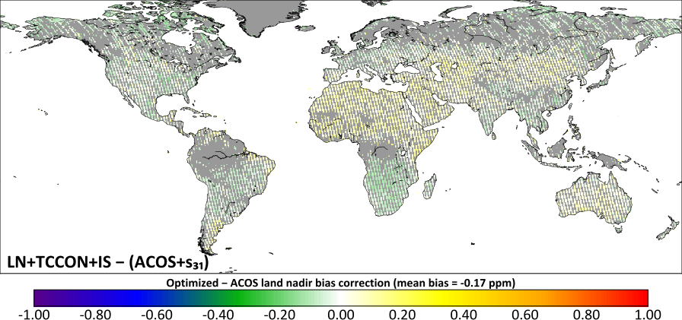
How different was it from the official bias correction?
The online bias correction was very close to the official bias correction, certainly within the error estimates of the latter, and produced a flux estimate that was (at the time) just as good as the inversion with the official product

Slide 12
Can the covariate selection be part of the analysis?
Yes, but not as part of the flux inversion. Covariate selection is a precursor step, using one or more truth metrics
Correction | s31 | albedo_2 | co2_grad_del | dp | logDWS
ACOS official | 7.0 | – | 0.0280 | 0.300 | 0.60
LN | – | 4.3 | 0.0272 | 0.304 | 0.66
LN+LG+OG | – | 3.7 | 0.0264 | 0.307 | 0.63
LN+insitu | – | 4.0 | 0.0248 | 0.305 | 0.64
LN+TCCON | – | 3.7 | 0.0263 | 0.306 | 0.65
LN+TCCON+insitu | – | 4.0 | 0.0248 | 0.304 | 0.64
All+TCCON+insitu | – | 3.7 | 0.0250 | 0.306 | 0.64
Uncertainty (%) | – | 25 | 3 | 2.5 | 17

Slide 13
New or improved data products?
There are now several strategies for averaging nearby retrievals with their correlated errors (Rijsdijk et al, 2025; Nüß et al, 2024; etc.), releasing this along with a standard XCO₂ product will greatly help global modelers
Harmonized data products from multiple satellites (will be difficult if the satellites are from different agencies)
Profile retrievals, even two degrees would be better than one

Slide 14
Validation/evaluation/weighting
Fluxes from global inverse models cannot be directly validated (unlike NWP), so two strategies:
  Upscaled eddy flux, hasn’t found much traction due to representativity
  Withheld or independent measurements, currently the gold standard
  Specific features of fluxes, such as the interannual variability in the summer drawdown over a region, can be correlated with (say) NDVI anomalies to determine “reasonableness”
Validation requires careful selection of withheld or independent data. Vertical curtains and Tropics are sporadic or missing.
Traditional strategies for weighting depends on posterior errors, which (a) may not be available, and (b) does not reflect validation

Slide 15
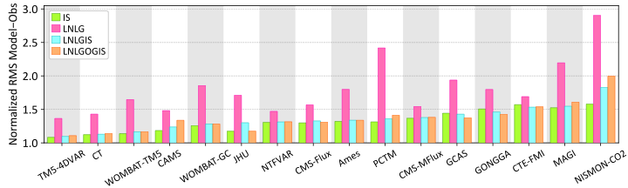
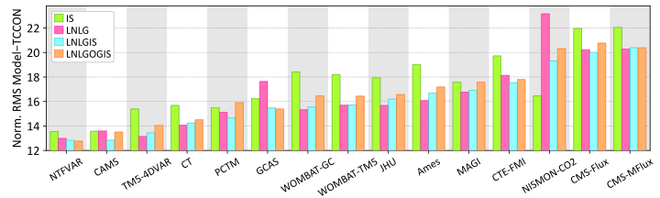
How to combine different validation metrics?
In situ
Groups ranked by their LNLGIS validation metrics, because that is the “release” product.
Some models are always better than others, but ranking not the same.
If we have to come up with a single answer, what weights to use? How do we merge different validation metrics?
TCCON

Slide 16
What could we do that is new?
Make multi-source flux estimation routine, e.g., multi-satellite XCO₂ + SIF + ¹⁴CO₂, because we ultimately want the component fluxes and processes
~10-50 km global inversions using either transport on GPUs or transport emulators
Quickly updated flux estimates with regular latency – requires dedicated personnel, not a research project (for low latency)
Since transport is a leading order bias, suggestion would be to include at least two transport models, either in the same framework or different frameworks

Slide 17
Extra slides

Slide 18
One slide history lesson
Following progress in NWP, first attempts to infer CO₂ surface fluxes from background measurements in the 1990s
Data gap quickly became a problem, CO₂-dedicated satellites planned (following NWP example) in the early 2000s, launched after a decade
Inversion methods advanced from TRANSCOM days to deal with the increased volume of data, both in situ and remotely sensed
We are now looking at almost a dozen CO₂-dedicated satellites by 2030, and an expanding in situ network across continents. While fantastic, this places unprecedented challenges on inversion and inter-calibration systems.

Slide 19
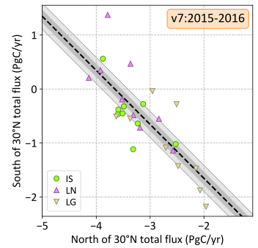
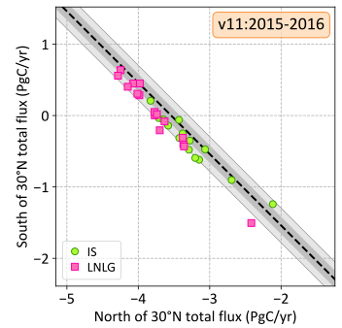
Progress from v7 to v11
The OCO2 data used to have a bigger range in the northern temperate partitioning, now it is comparable if not smaller
Notes:
output_dir = os.path.join(os.environ['HOME'], 'Documents/Talks/OCO2/SAC Workshop’)
fbp1.diver_down(['IS','LN','LG'], ('north of 30°N', 'south of 30°N'), ('total','total'), gr_cons=True, small_ticks=True, verbose=False, gr_tol=True, tol_method='diff', years=[2015,2016], annot_text='v7:2015-2016', range=3.91)
savefig(os.path.join(output_dir, 'diver_down_nextratrop_v7.pdf')) ; close()
fbp4.diver_down(['IS','LNLG'], ('north of 30°N', 'south of 30°N'), ('total','total'), gr_cons=True, small_ticks=True, verbose=False, gr_tol=True, tol_method='diff', years= [2015,2016], annot_text='v11:2015-2016', range=3.91)
savefig(os.path.join(output_dir, 'diver_down_nextratrop_v11.pdf')) ; close()

